Slide 1
Notes on Pupper Source Code

Slide 2
Pupper Kinematics & Geometry

Slide 3


1
3
Front
Frame Type:
x-y-z: Front-Left-Up
Frames:
{B}: Body
{H}: Hip
x
2
4
Left
y
Down View
LEG_FB
{B}
$$α_{abduction}$$
LEG_LR
{H}
$$φ$$
LEG_L1
Trident
$${−α}_{HIP_FOOT}$$
$$θ$$
$$β$$
R_{HIP_FOOT}
LEG_L2
Side View
$$α_{hip}=θ+trident$$
$$α_{knee}=α_{hip}−(π−β)$$
{F}
Back View

Slide 4
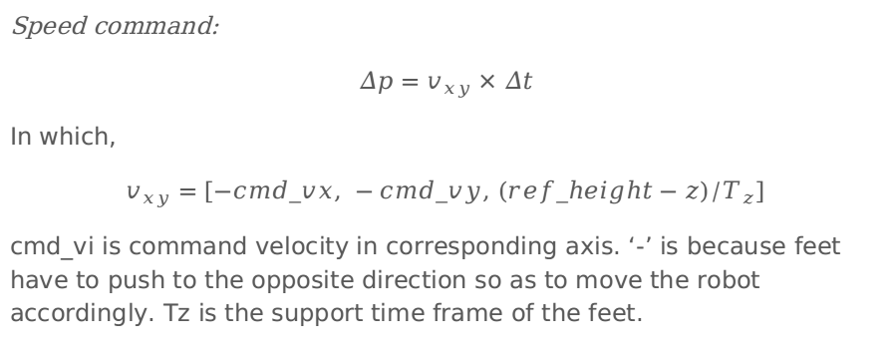
Stance Controller
Speed command:
$$Δp=v_{xy}×Δt$$
In which,
$$v_{xy}=[−cmd_vx, −cmd_vy, (ref_height−z)/T_{z}]$$
cmd_vi is command velocity in corresponding axis. ‘-’ is because feet have to push to the opposite direction so as to move the robot accordingly. Tz is the support time frame of the feet.
Notes:
Refer to Raibert’s book

Slide 5
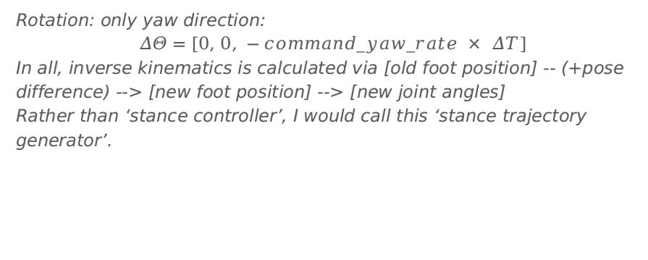
Stance Controller
Rotation: only yaw direction:
$$ΔΘ=[0, 0, −command_yaw_rate × ΔT]$$
In all, inverse kinematics is calculated via [old foot position] -- (+pose difference) --> [new foot position] --> [new joint angles]
Rather than ‘stance controller’, I would call this ‘stance trajectory generator’.

Slide 6
Swing Controller
swing height
Swing Height
Touchdown location:
R@[delta_x, delta_y, 0] + delta_p
delta_p = alpha*stance_time*cmd_V
R=eular2mat(0, 0, yaw = beta*stance_time * cmd_yaw_rate
alpha, beta: Ratio between touchdown distance and total horizontal stance movement??
z_clearance
time
swing_phase

Slide 7
Gait Controller
Check which gait robot is in, therefore which behavior each leg should be following

Slide 8
Controller
Check each leg according to ticks: Stance OR Flight?
State FSM: (every command is an ON/OFF button, but not a switch with specified ON or OFF)
Hop: |z| small -> large Rest: stand still but compensate for roll/pitch angle
Activate
DEACTIVATED
REST
TROT
Trot
Hop
FINISH_HOP
HOP

Slide 9
Why is correction_factor for roll and pitch not 1.0?
Guess: to avoid oscillation. Servo bandwidth is not unlimited.

